Slide 1
Design Anti-Patterns
James Coyle, Xavier Oliver, Sean Khanna, Flavio Fiori & Flaviu Orban

Slide 2
Anti-Patterns: What are they?
James Coyle

Slide 3
Anti-Patterns: What are they?
The opposite of design patterns
Design patterns can become anti-patterns
So what makes an Anti-pattern?
A pattern that seems beneficial, but produces more bad consequences than benefits
Refactored solution exists which is clearly documented and proven in actual practice and repeatable
These distinguish anti-patterns from bad habit, practice or ideas
Notes:
“If design patterns are the good guys then anti-patterns are the bad guys”
So imagine that you have just learned a new design pattern and are really proud, now you start to use it absolutely every, suddenly this design pattern becomes overused and subsequently stops you from clearly defining a true solution.
Design anti-patterns can be defined using two key elements..
If you’re using a design pattern a lot and subsequently it produces more bad consequences that beneficial results, it may appear beneficial to the problem but using it is making the solution worse, not better.
The design pattern must be documented for the pattern to be considered an “anti-pattern”
These two points ensure that you cannot brand bad habits, bad practice or bad ideas as anti-patterns.

Slide 4
Anti-Patterns: What are they?
The term was formed after the “Gang of Four Design Patterns” book was released. The book: AntiPatterns was written as a response to it in 1998
In short, Anti-Patterns are considered bad programming practices
Patterns that are considered bad software development practices are anti-patterns
Notes:
The term was formed after the “Gang of Four Design Patterns” book was released. The book: AntiPatterns was written as a response to it in 1998
Anti-Patterns = bad, Design-Patterns = good.

Slide 5
Anti-Pattern “good” Example
Fiori

Slide 6
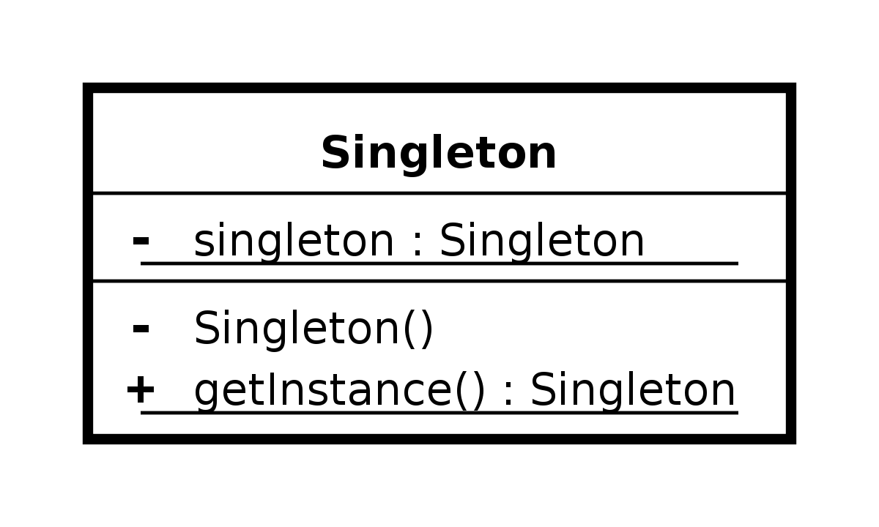
Singleton Over Use
Singleton is a Design Pattern
Variable Information can be accessed everywhere
How it can become an anti-pattern?
When the overusing of singletons is present in the program
Information is not protected and can be accessed globally.

Slide 7
Cut-And-past programming
Easy way to duplicate functionality
Maintenance problems
Alternative forms of reuse
Black-Box reuse
White-Box reuse
Notes:
As the name implies, somebody copied some code from some place to another place. It is the simplest way to duplicate functionality, but it should be avoided due to the fact that it leads to significant maintenance problems The simplest solution is to turn the code into a method instead (Black box reuse)
----------------------------------------------------------------------------------------------------------------------------------------------------------------------------------------------
-Black box reuse is using the copied code and insert into a class or function unmodified
-White box reuse is taking the copied code insert into a class/function/ modify it to suit the needs of your project.

Slide 8
Spaghetti code
Unreadable code
Programs often work but are difficult to maintain
Do not follow the rules of structured logic.
Examples
Create functions when you do not need to.
Use the goto statement everywhere.
Notes:
If you already have a function that is doing something,
Break it down into three or four functions each and for each of those break it down into functions too.
The only way to read the code is going to be jumping from function to function to function

Slide 9
Where HAVE WE used Anti-Patterns
Programming:
Accidental complexity
Action at a distance
Lava flow
Object Oriented Programming:
Call super
God object
Object orgy
Poltergeists

Slide 10
How Anti-Patterns can negatively impact principles
Xavier Oliver

Slide 11
Methodological
Copy-paste programming
Premature optimisation
Dependency hell
Analysis paralysis
Vendor lock-in
Smoke and mirrors
Rule of credibility /ninety-ninety rule
"The first 90 percent of the code accounts for the first 90 percent of the development time. The remaining 10 percent of the code accounts for the other 90 percent of the development time."
— Tom Cargill, Bell Labs
Notes:
Before having all the details you try to optimize
Analysis paralysis in when you just keep analyzing to the point no work actually gets done
Vendor lock-in locking yourself into a certain program or environment like .net meaning you are now at the mercy of any changes they make and their rules (is that optimal)
Smoke and mirrors, Demonstration systems, vertical slice of a game end user suffers doesn't get the desired product

Slide 12
Technological
Cargo cult programming
Big Ball of mud
Circular dependency
Sequential coupling
Hard codded assumptions
Code Smells
Notes:
Cargo cult programming goes hand in hand with copy paste programming. When learning a new language you may do things just because you see others do it without understanding it.
Putting in a main function but not knowing why. something you should eventually grow out of by learning the language more and what things mean
All things in one class, going back to the main function I said early when starting out you may just put line after line in that one function. Obviously not object oriented so can get messy
Circular dependency, when updating one function you may need to update many some completely unrelated
Have to do a before you b. opening a file then using a file then closing a file. Have to keep track of what state the file will be in because depending what you want to do with it your code wont work
Hardcoding, using constants instead of variables in places

Slide 13
How do Anti-Patterns relate to “Code Smell”?
Sean Khanna

Slide 14
What are code smells?
Commenting
Long Methods
Long Parameter List
Shotgun Surgery
Indecent exposure
http://www.industriallogic.com/wp-content/uploads/2005/09/smellstorefactorings.pdf
Notes:
Simply put code smells are just bad coding practices. At this early stage for example, we all need to learn to code better with every day. Using good commenting. We don’t always need to comment. Over commenting can actually make it harder for people to understand your code. If the method name for example, explains enough then you have no need to flatter it with comments.
Over sized methods are never good if you can limit the method or split it into smaller methods then you should try to.
The more parameters you use within a method will inevitably complicate it, you should try to limit the number of parameters you enter or alternatively you can combine them into an object which leads me onto shotgun surgery.
Like Uncle Bob says in the video we've seen previously, bad code can happen when you change one thing, which then leads to something else needing to be changed and so on. A way around that could be to pass in an object, that way you wouldn’t have to change all the other classes or methods that get affected.
Its not quite what you think it is. Indecent exposure is, when your filling out classes and you set things to private and public. You want to limit as much of the internals of the class as possible, if it does not have a real need to be public then set it to private.
There many many more, you can find here and ways to refractor you code.
Now when you think about it code smells arn’t bad, its like a block of cheese that hasn’t quite gone off yet but, the longer you leave it the worse its going to get.

Slide 15
How is it related to anti-patterns?
Not quite as formal as anti-patterns
Kent Beck and Martin Fowler
Refactoring. Improving the design of existing code.
Notes:
This idea of code smells being ok or bad was first introduced by Kent beck and Martin fowler in the 1990s and made it into a popular book called Refactoring. Improving the design of existing code.

Slide 16
Thank you
Questions?

